Slide 1
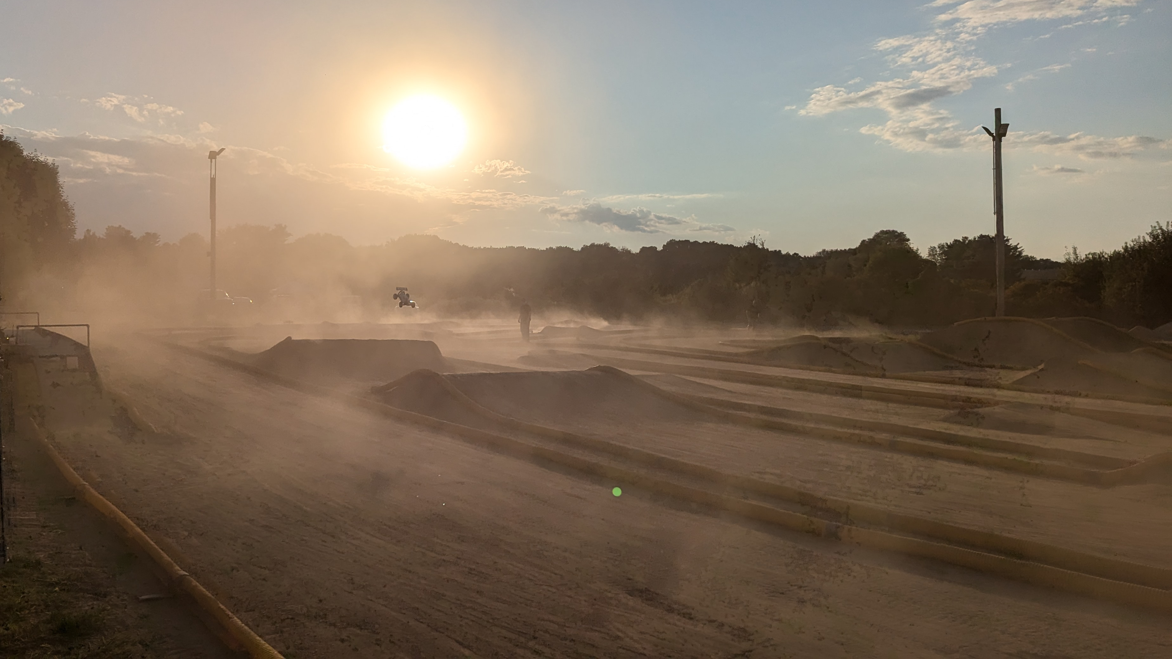
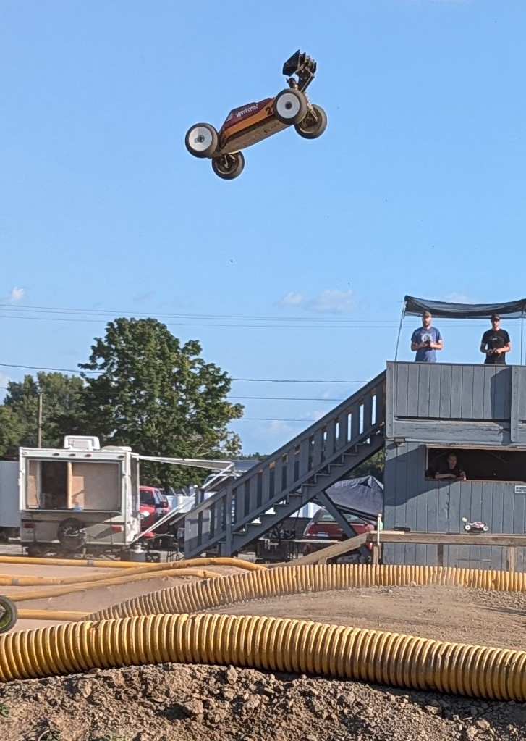
CISC-6100: Software Engineering
Deriving components
Establishing communication
Project Management
Week 4 – September 23

Slide 2
Outline for today’s class
Review of homework
Picking up where we left off:
Deriving major functionality from storyboards
Drilling into components
Sequence Diagrams
Homework
Project plans
Representing algorithms (Activity diagrams)

Slide 3
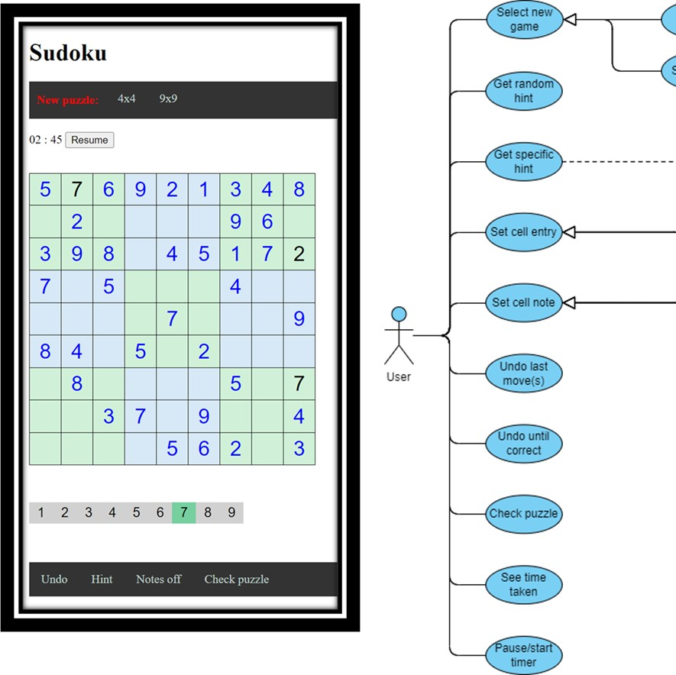
Homework review
Read chapter 6 in our textbook.
Identify the design principle that is most meaningful to you
Explain your reasoning in 3-5 sentences
Become domain conversant
Scenario-based modeling
Understand the problem you are trying to solve.
Draw a picture
You are not alone!
Design with readability in mind
Someone (else) will maintain the software
Work products to provide value
Consistency
Change happens!
Models that are amenable to change
Be ready to adapt
Accommodate change
Technical best practices
Importance of the design of data
Work with layers of abstraction
Separation of interfaces and implementations
Design for testing
Test small to large

Slide 4
Deriving components: task or scenario driven design
Observations from watching the class work on the white board exercise last week:
Trying to figure out algorithms instead of high-level capabilities (which will eventually include algorithms)
Still working on user-level design (the UI/UX) rather than moving on to how each task will work

Slide 5
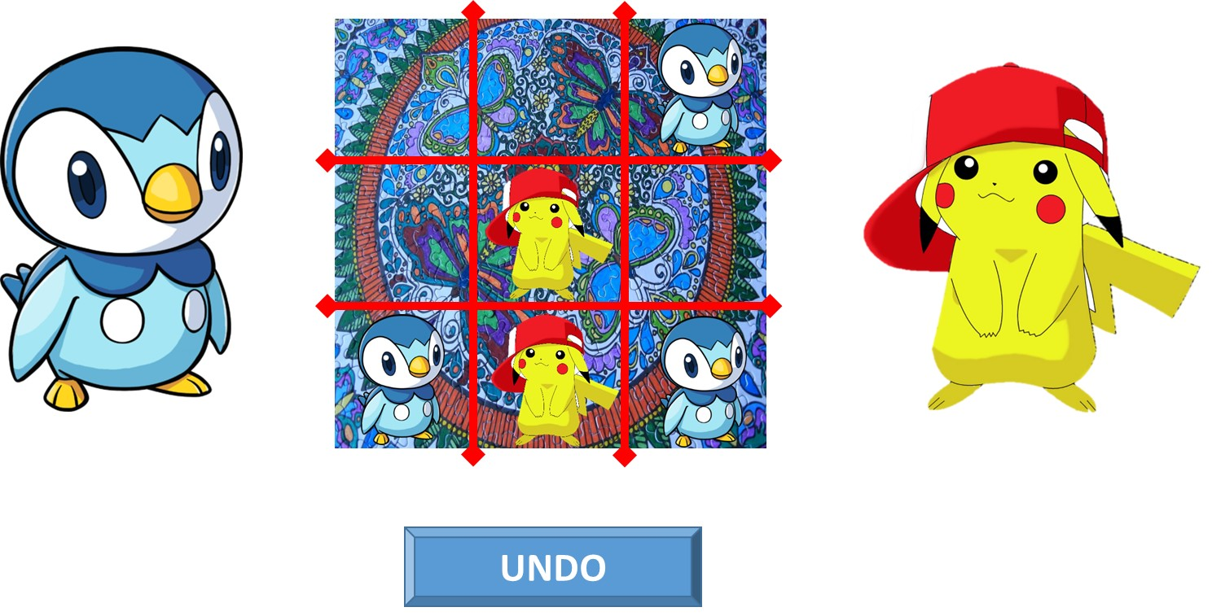
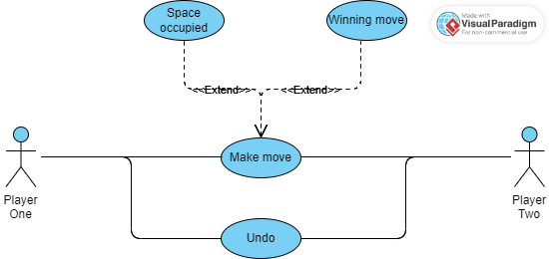
Deriving components (example): use case driven design
Focus is on what are the high-level steps, NOT how to do the steps
Game Begins:
Draw board
Draw players
Create “Undo” button, faded out
Set turn to left-side player
Draw lights
Make a move - Location selected:
If location selected not already occupied
Put current player’s representation at location selected and record move
If move wins game
Show winning path
Prompt for another game …
Restart or exit
Make “Undo” not faded out
Change turn to other player
If location already selected notify player to select an empty location
Undo selected:
Remove last move from board
Change turn back to previous player

Slide 6
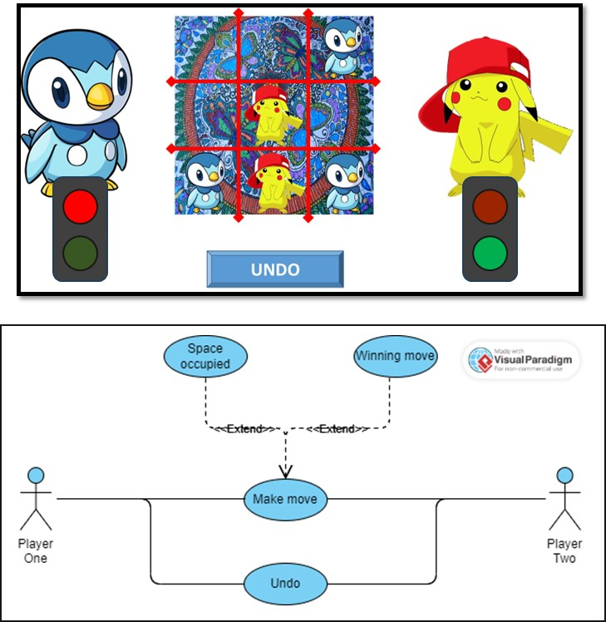
Deriving components (example): use case driven design
Game Begins:
Draw board
Draw players
Create “Undo” button, faded out
Set turn to left-side player
Draw lights
Location selected:
If location selected not already occupied
Put current player’s representation at location selected and record move
If move wins game
Show winning path
Prompt for another game …
Restart or exit
Make “Undo” not faded out
Change turn to other player
If location already selected notify player to select an empty location
Undo selected:
Remove last move from board
Change turn back to previous player
Graphical User Interface
(GUI)
Handle user input
Update user display
Game representation
(Data structures/classes)
Turn
Board
Move history
Game Engine
Legal move?
Make move
Winning move?

Slide 7
Deriving design information
For the task assigned to your group:
Trace through and record all steps you can think of that a program must go through to complete the task (both for desired outcomes and exceptions)
Keep track of any incompletely specified requirements/questions that come up
Class exercise
Then as a full class:
List all
Cluster

Slide 8
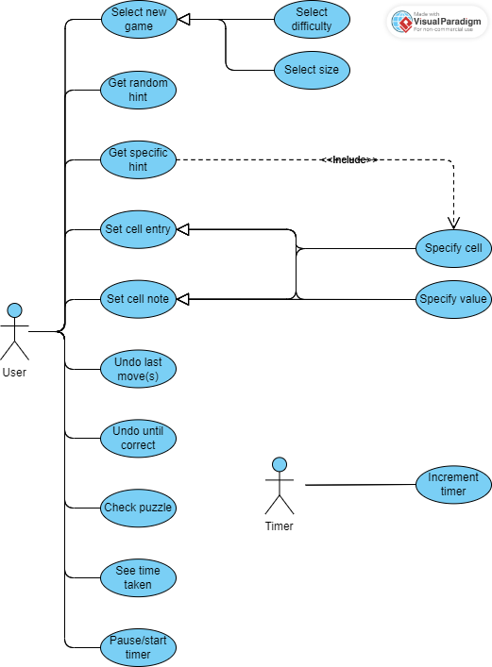
Use Case Diagram (high-level)
F
Puzzle app is started:
Draw screen, Get or generate new puzzle, Initialize history, Initialize timer, Puzzle generator, Database, Puzzle representation, Solve puzzle, Draw puzzle
Select new game (F):
Event handler, Select difficulty, Difficulty representation, Select size, Size representation, Get or generate new puzzle, Display puzzle, Puzzle representation, Solve puzzle, Initialize history, Initialize timer, Puzzle generator, DB
Get random hint (A):
Event handler, Get random hint, Puzzle representation, Update cell
Get specific hint (A):
Event handler, Select cell, Get specific hint, Puzzle representation, Update cell
Set cell entry (B):
Event handler, Set value entry mode, Select value, Select cell, Set value, Puzzle representation, History representation, Update cell, Mode representation
Set note entry (B):
Event handler, Set note entry mode, Set note, Select value, Select cell, Puzzle representation, History representation, Update cell, Mode representation
A
A
B
B
C
C
E
D
E
E

Slide 9
Use Case Diagram (high-level)
F
Undo last move (C):
Event handler, Undo last, Puzzle representation, History representation, Update cell, Update history
Undo until correct (C):
Event handler, Undo until correct, Puzzle representation, History representation, Update cell, Update history
Check puzzle(D):
Event handler, Check puzzle, Puzzle representation, Update cell, Highlight puzzle?, Message?
See time taken (E):
Display clock, Time representation
Pause/start timer (E):
Event handler, Toggle timer, Timer mode representation, time representation
Increment timer (E):
Event handler, Clock tick, Time representation, Display clock
A
A
B
B
C
C
E
D
E
E

Slide 10
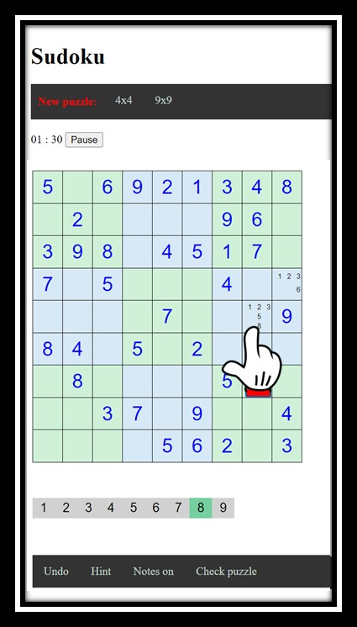
Event tracing:
Start a puzzle from the library
Undo until correct
Get a random hint
Make entry in puzzle
Make note in cell
Start a puzzle of specified size/difficulty
Screen Management
Run-time/long-term
representations
Actor Actions
Event Handlers
Algorithms
MainMenuSelect(…)
RequestHint(…)
DrawPlayScreen(…)
SetValue(…)
CurrentCell
SolvePuzzel(…)
SelectBoardSize(…)
SelectCell(…)
UpdateCell(…)
SetNote(…)
Puzzle
GeneratePuzzel(…)
SelectDifficulty(…)
RequestUndo(…)
UpdatePuzzle(…)
UndoLast(…)
History
RankDifficulty(…)
SelectValue(…)
RequestCheck(…)
UpdateClock(…)
UndoUntilCorrect(…)
ElapsedTime
ToggleNotesMode(…)
ClockTick(…)
DisplayMessage(…)
Hint(…)
Solution
NewPuzzle(…)
PuzzleLibrary(…)
NewPuzzle(…)
Mode
LoadPuzzle(…)
Database

Slide 11
Quick review
Steps so far …
Requirements analysis
Customer supplies high-level specs
Story boards created for key aspects
Further clarification of customer requirements using use-case diagrams and scenarios
Rapid prototype
Identify high-level components
Group high-level components
Next steps …
Design analysis
Component diagrams
Sequence diagrams

Slide 12
Component Diagrams
Shows various components in a system and their dependencies, interfaces
Explains the structure of a system
Usually a physical collection of classes
Used to group elements into logical structures
All the model elements are private with a public interface

Slide 13
Component diagrams
Help us to:
Divide and conquer
Achieve higher levels of abstraction
Focus on the transfer of information
Build software that exhibits effective modularity
Some of the design principles from our book.
They represent best practices

Slide 14
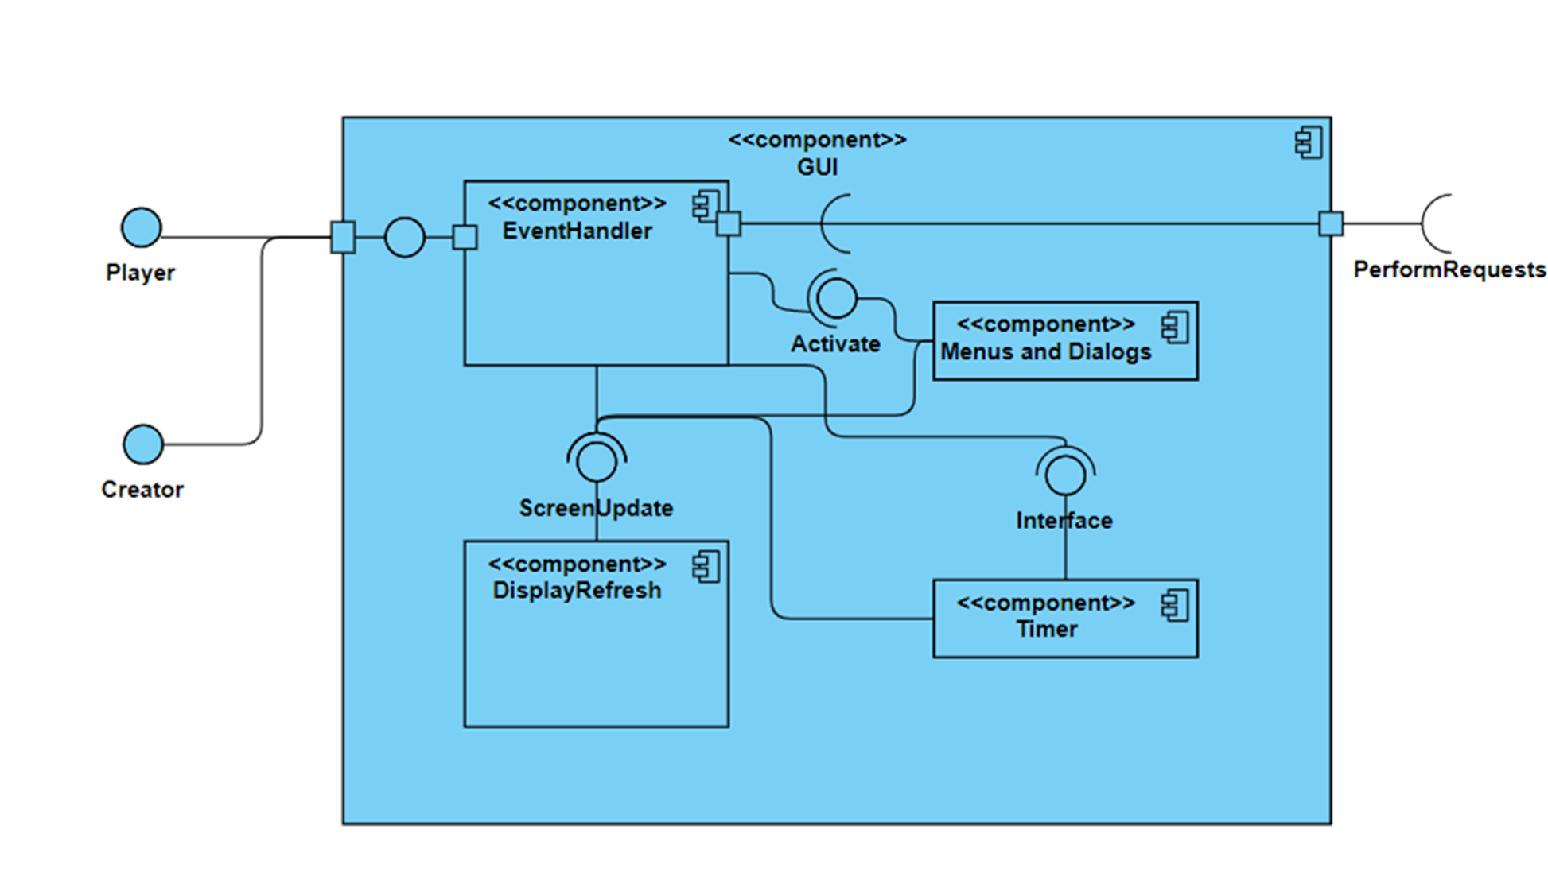
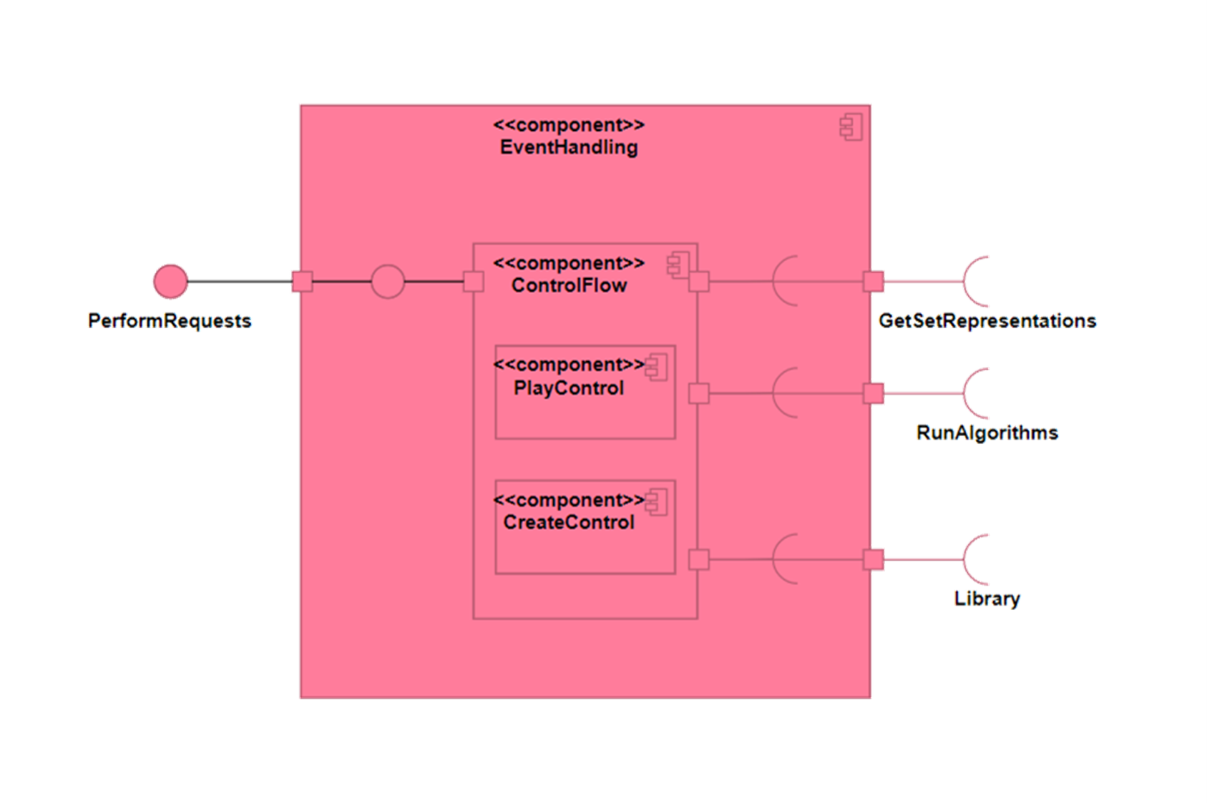
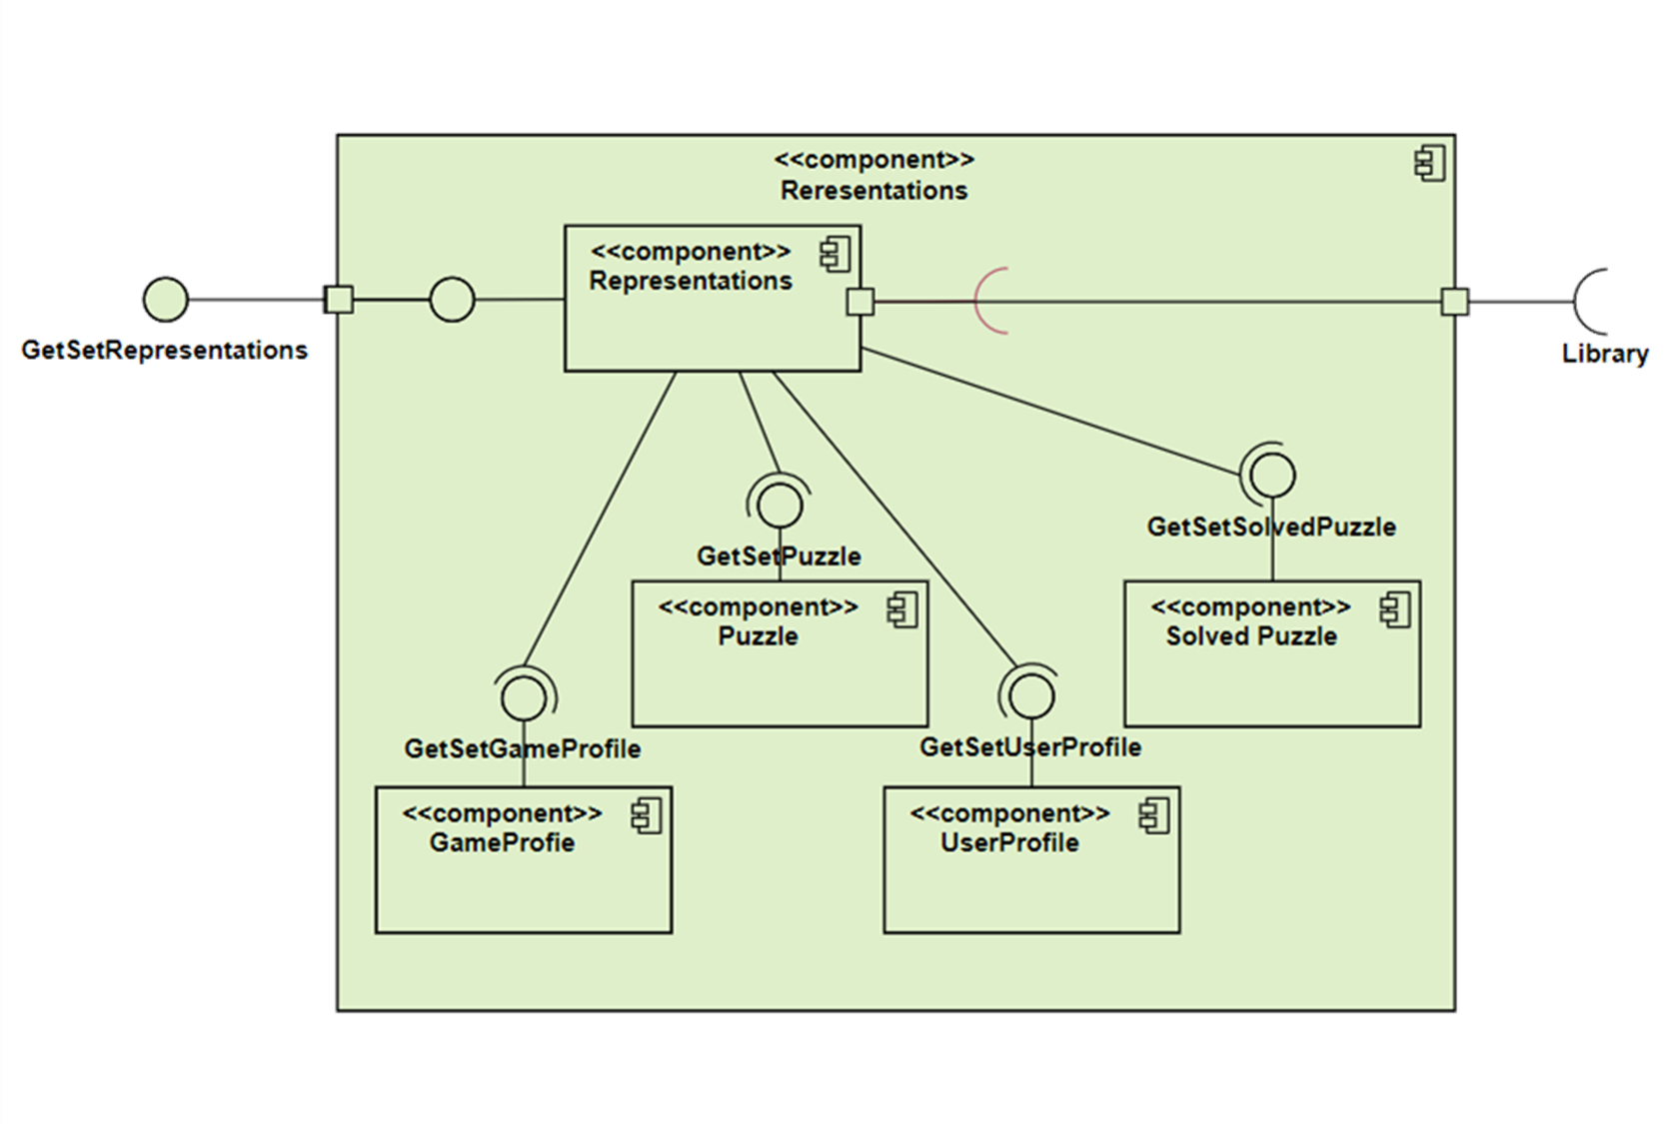
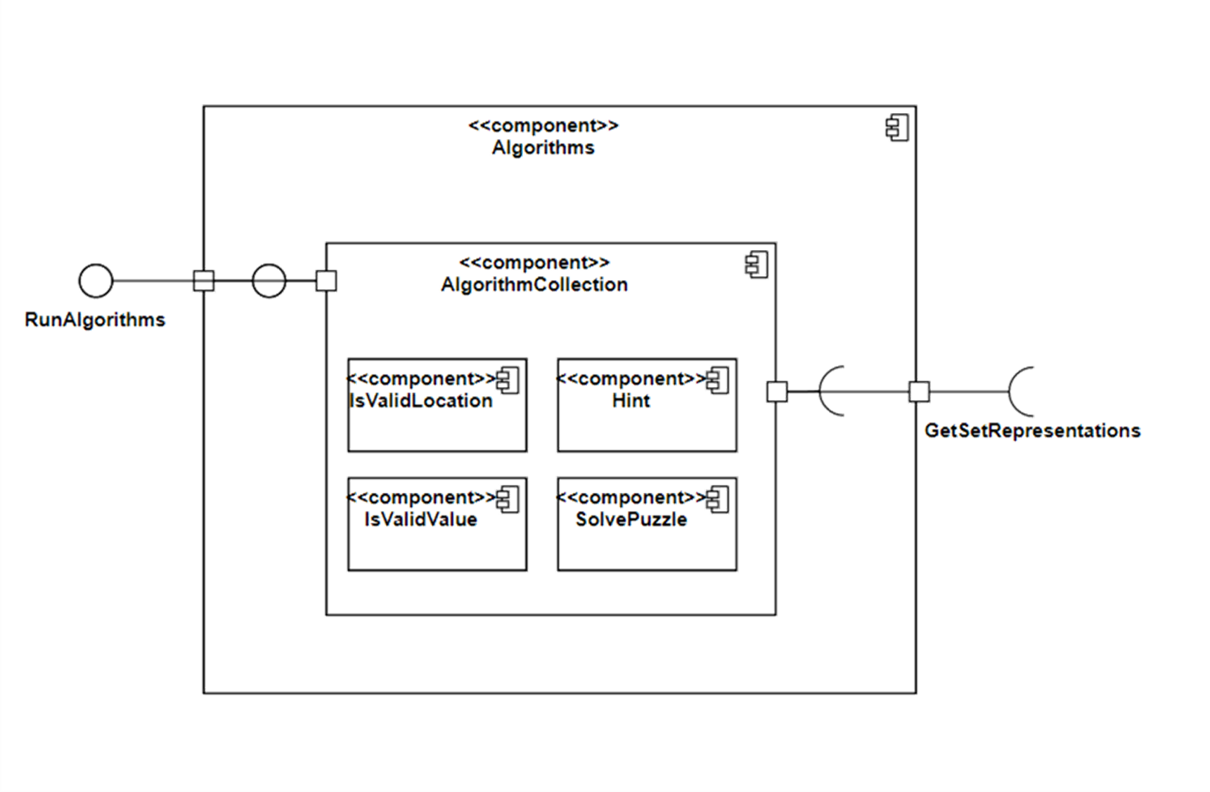
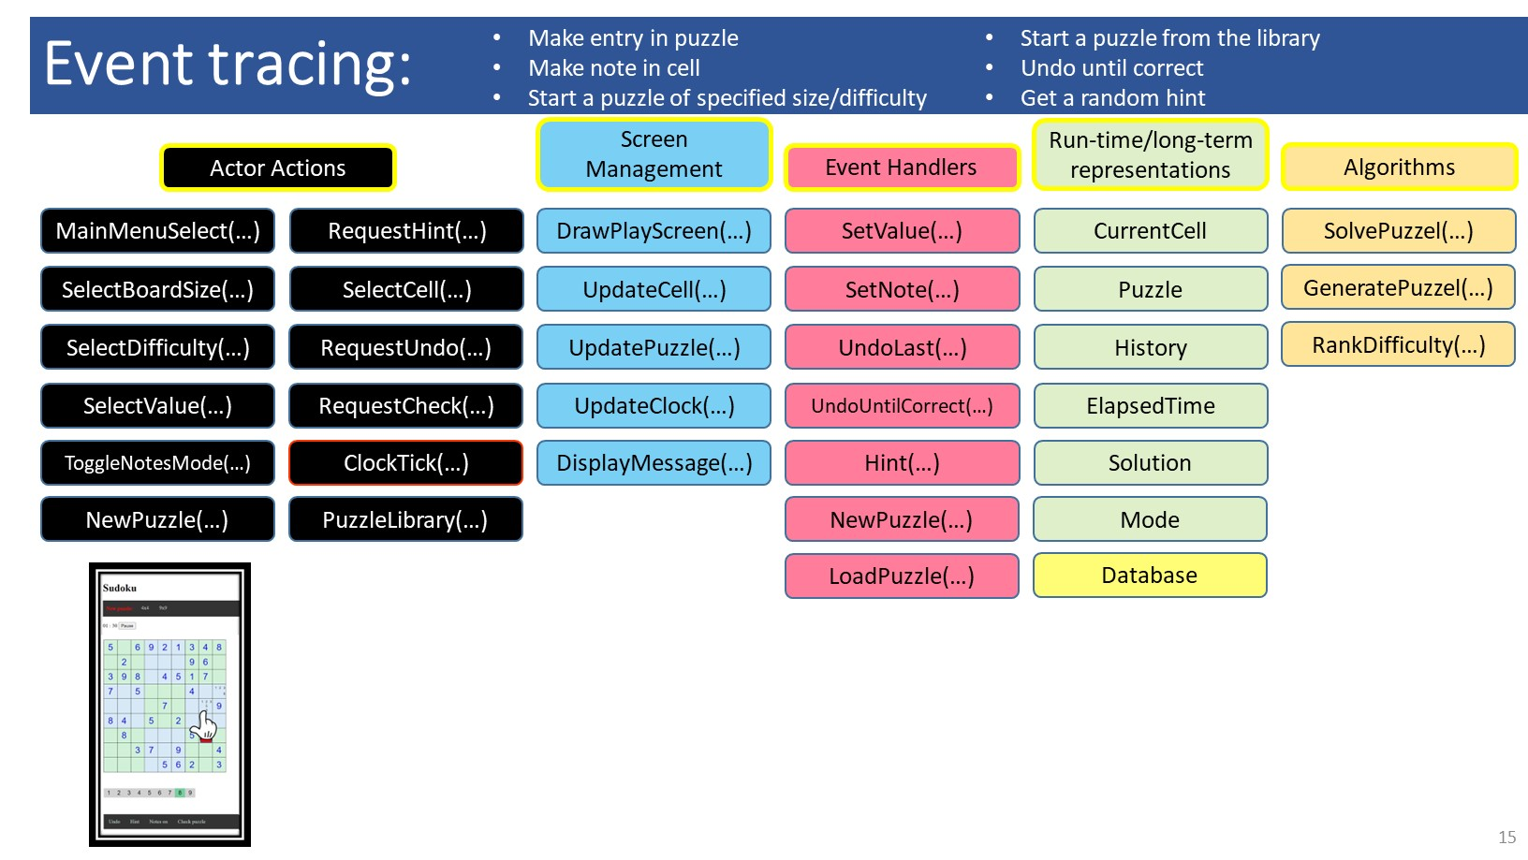
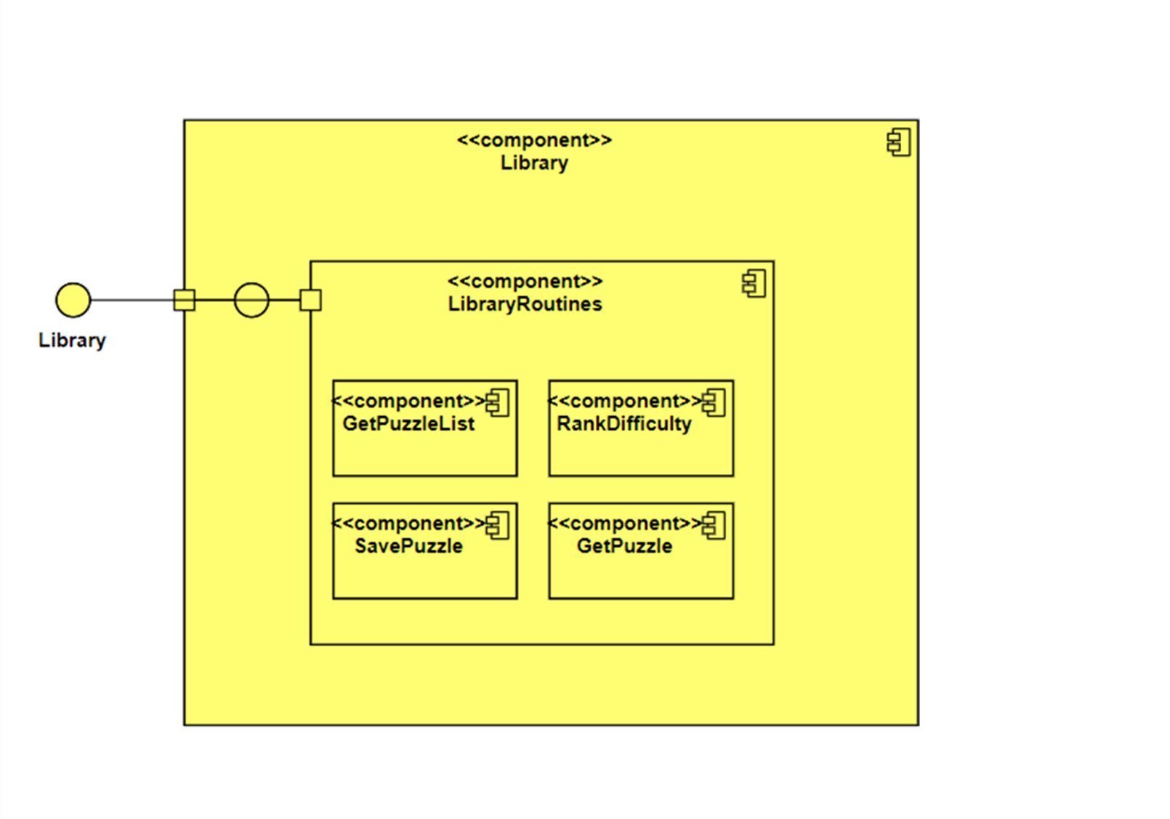
Graphical User Interface
Event handlers
(Game engine)
Run-time representations
Algorithms
Database

Slide 15
Component Diagram

Slide 21
Possible implementations …
What follows is not necessarily what would be done next. I’m showing you now to show you where what we have done will eventually lead to

Slide 22
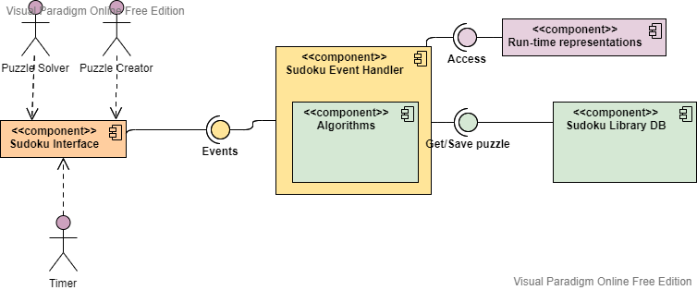
High-level component diagram
Standalone app

Slide 23
One possible system diagram
REST
CRUD
JSON
HTTP
JSON
Browser client
JavaScript
CSS
HTML
Web Server
MongoDB
Web Server
C++
Local front-end with dynamic server running the puzzle logic

Slide 24
Another possible system diagram
File I/O
DLLs
System call
Python
JSON
Web Server
Python
MongoDB
Standalone PC app
C#
Game engine
C++
Frontend display with dynamic server running the logic

Slide 25
Another possible system diagram
File I/O
Swift <==> C++ bridge
System call
Python
JSON
Web Server
Python
MongoDB
iPhone app
Swift
Game engine
C++
Mobile app display with dynamic server running the app

Slide 26
Sudoku
Internet
Browser
Server

Slide 27
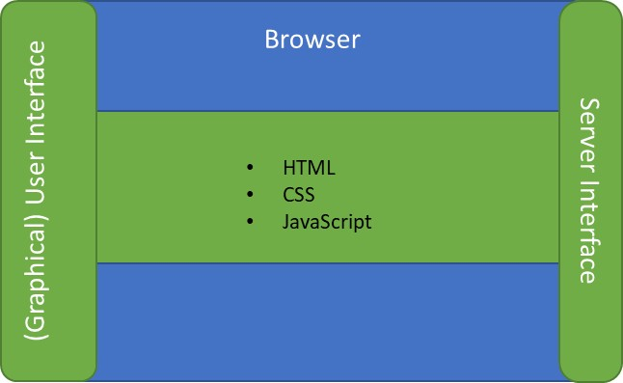
Sudoku
Database
(puzzles)
Internet
Browser
URL parser
Graphical User Interface
(view)
Server
(GitHub Pages)
HTML
CSS
JavaScript
http request
URL
Sudoku representaton
(model)
Sudoku engine
(controller)
http response
Web page
Running in browser with static server supplying code

Slide 28
Sudoku
Database
Internet
Graphical User Interface
(view)
JSON encoder/decoder
URL encoder
URL parser
State save/load
Browser
Server
JSON encoder/decoder
Sudoku engine
(controller)
HTML
CSS
JavaScript
http request
URL
JSON
Django
SQLite
Python
Sudoku representaton
(model)
http response
JSON
Browser display with dynamic server running the app

Slide 29
Interaction Diagrams
Interaction diagrams are dynamic -- they describe how objects collaborate
Sequence Diagram:
Indicates what messages (function calls, method instantiations) are sent and when
Time progresses from top to bottom
Components involved are listed left to right
Messages are sent left to right among components in sequence
Free to use toolkit for drawing UML diagrams (and more):
https://online.visual-paradigm.com/

Slide 30
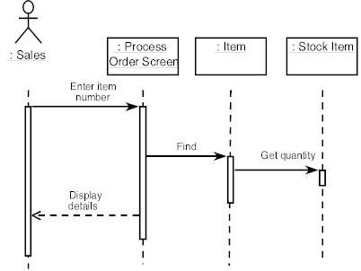
Sequence Diagram Format
Actor from
Use Case
Objects
1
Activation
2
3
4
Lifeline
Calls = Solid Lines
Returns = Dashed Lines

Slide 31
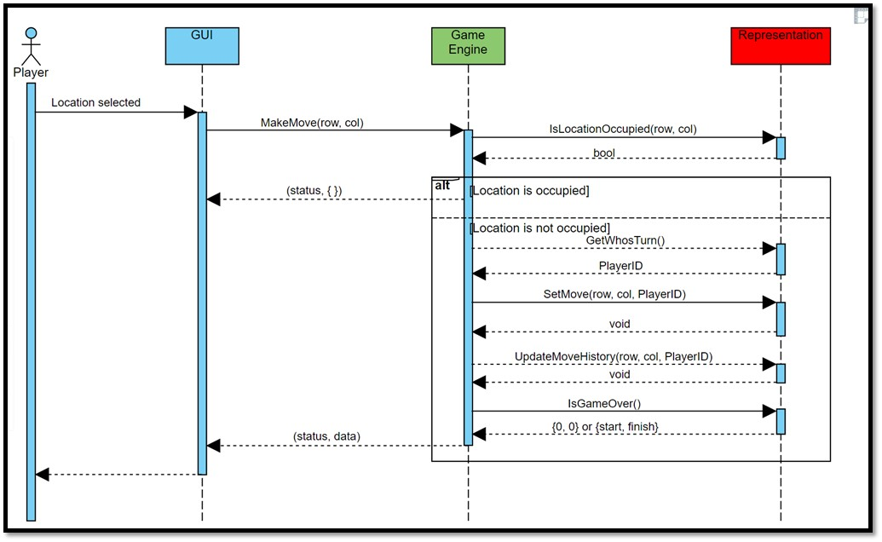
Deriving components (example): use case driven design
Game Begins:
Draw board
Draw players
Create “Undo” button, faded out
Set turn to left-side player
Draw lights
Location selected:
If location selected not already occupied
Put current player’s representation at location selected
If move wins game
Show winning path
Prompt for another game …
Restart or exit
Make “Undo” not faded out
Change turn to other player
If location already selected notify player to select an empty location
Undo selected:
Remove last move from board
Change turn back to previous player
Graphical User Interface
(GUI)
Game representation
(Data structures/classes)
Turn
Board
Move history
Game Engine
Legal move?
Make move
Winning move?

Slide 32
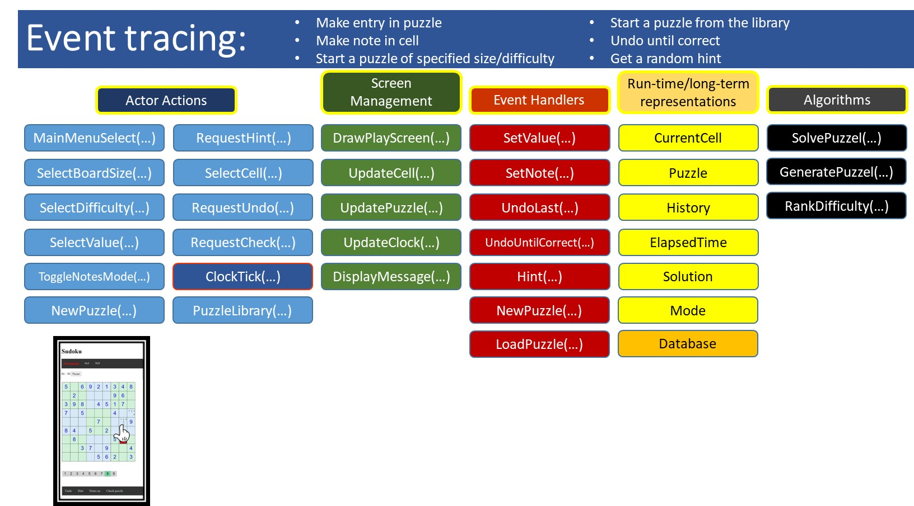
Create a sequence diagram …
Create a UML sequence diagram for:
Team A: Set cell entry
Team B: Undo last move
Team C: Set cell note
Team D: Check puzzle
Team E: Select new game
Team F: Get specific hint
Pause/Start timer
Get random hint
Undo until correct
You will start this exercise as a team, but for homework each individual should complete the task.
In class:
Get the idea of how to draw
Get far enough to ask questions
For homework:
Complete diagram
Enter into a drawing tool

Slide 33
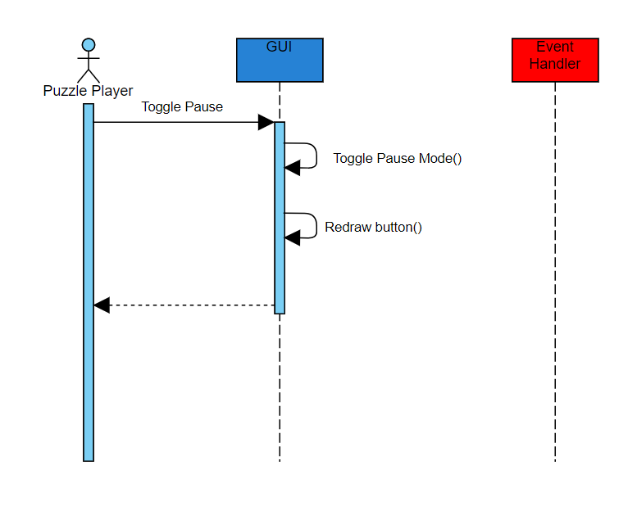
Create a sequence diagram …
Example of drawing this diagram in Visual Paradigm

Slide 34
Project management tools
Purpose
Planning
Fixed deadline
Fixed deliverable
Progress tracking
User tracking
Scheduling
Issue tracking
Billing
Timecard generation
Communication
Examples
Zoho
Excel
Mindmap extensions,
Microsoft Project, ..
https://en.wikipedia.org/w/index.php?curid=659967
https://skillforge.com/microsoft-project-formatting-gantt-chart-summary-task/

Slide 35
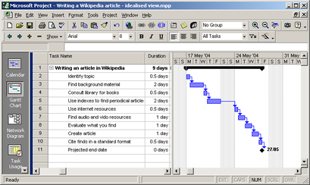
Project management tools
https://skillforge.com/microsoft-project-formatting-gantt-chart-summary-task/

Slide 36
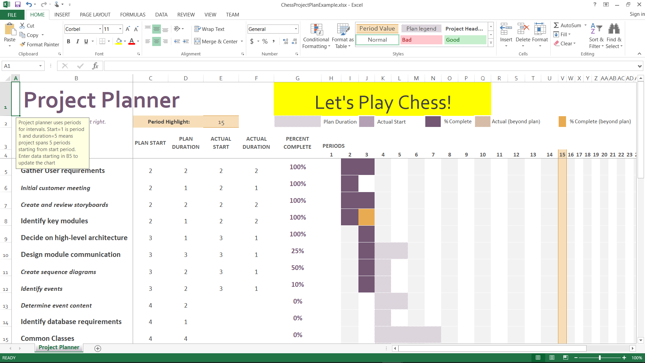
Project management tools

Slide 37
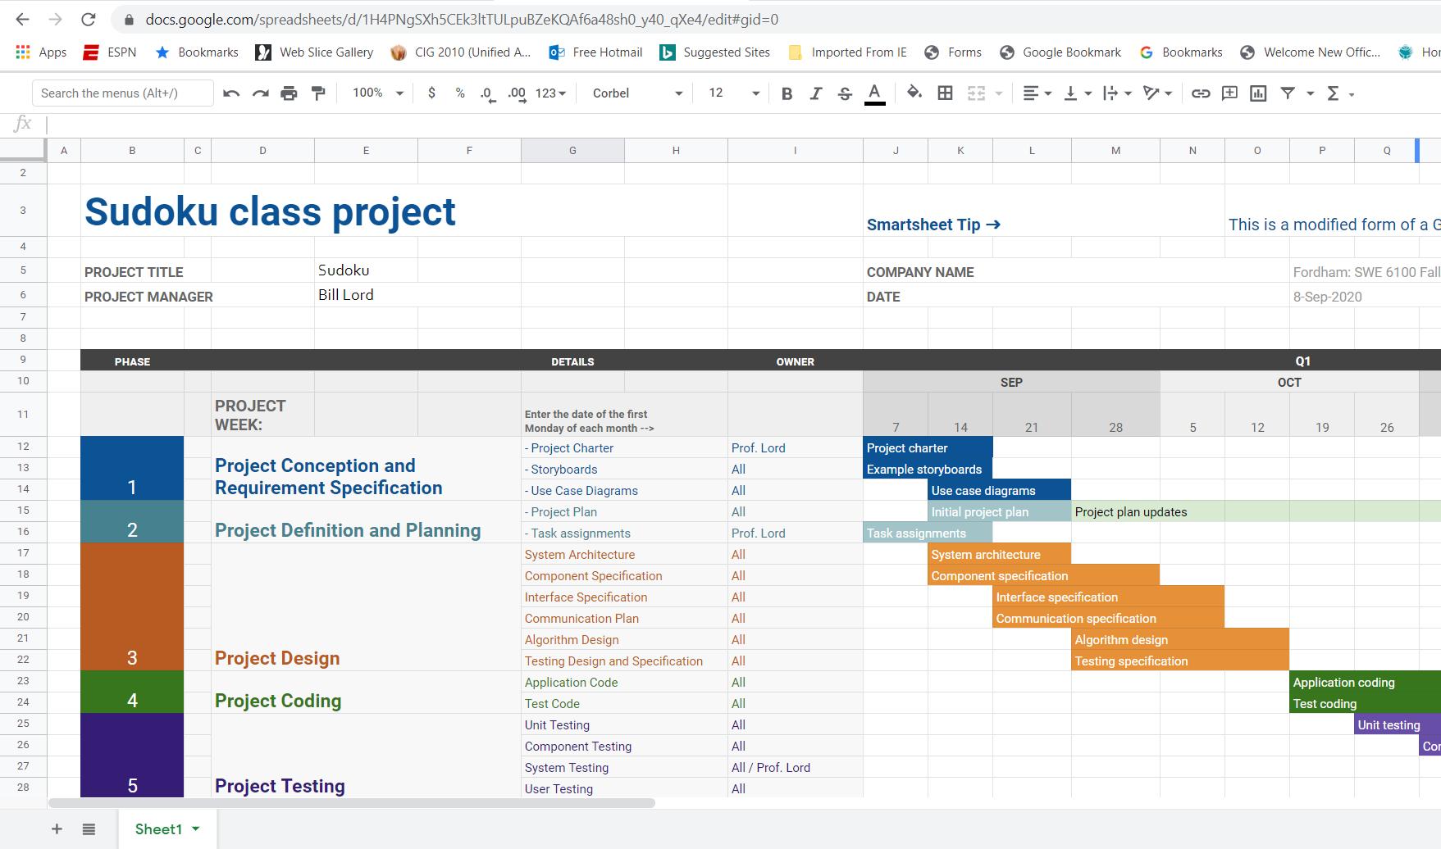
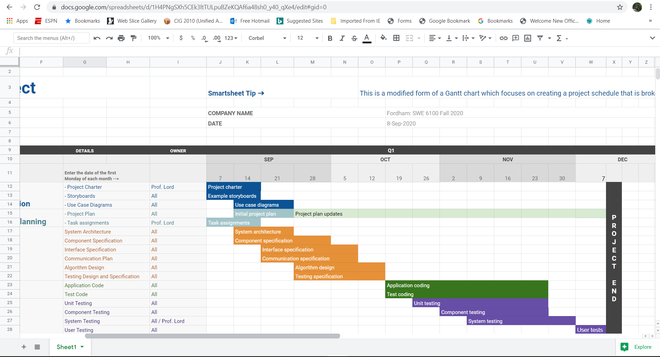
Project management tools

Slide 38
Project management tools
For our purposes (i.e. a simple project with small teams) using Excel or Sheets will suffice, but I recommend using Project:
Widely used in industry
Free to students?
After learning curve, easier to use
More automated graphical representations

Slide 39
Homework
Read through Chapter 8: Requirements Modeling – A recommended Approach
If desired, choose a new name for your team!
To be done individually and then tried with AI
Create a UML sequence diagram for:
Team A: Set cell entry
Team B: Undo last move
Team C: Set cell note
Team D: Check puzzle
Team E: Select new game
Team F: Get specific hint
Start a project plan using a tool of your choice. Populate it with:
Gathering user requirements
Generating technical requirements
Documenting testing specification
Implementation
Testing
Use the reading as:
Second opinion
Reinforce class learning
Reference
Sneak peak of what’s ahead

Slide 40
Extra / bonus slides

Slide 41
Activity Diagrams
Fancy flowchart
Displays the flow of activities involved in a single process
States
Describe what is being processed
Indicated by boxes with rounded corners
Swim lanes
Indicates which object is responsible for what activity
Branch
Transitions that branch
Indicated by a diamond
Fork
Transition forking into parallel activities
Indicated by solid bars
Start and End
Should be easy for a competent programmer to translate into code

Slide 42
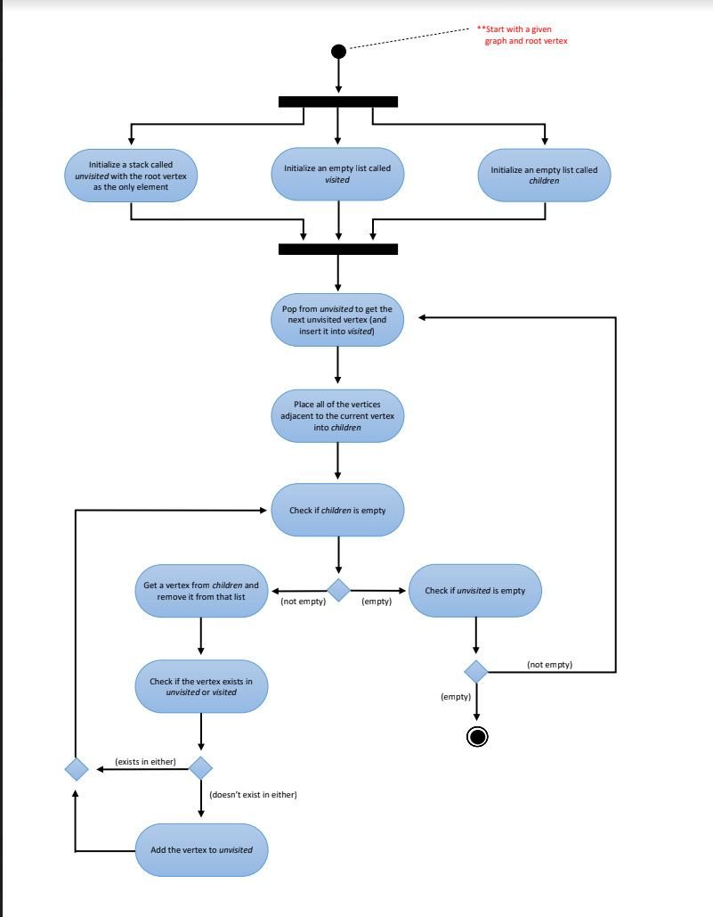
Homework
1
2
3
4
5

Slide 43
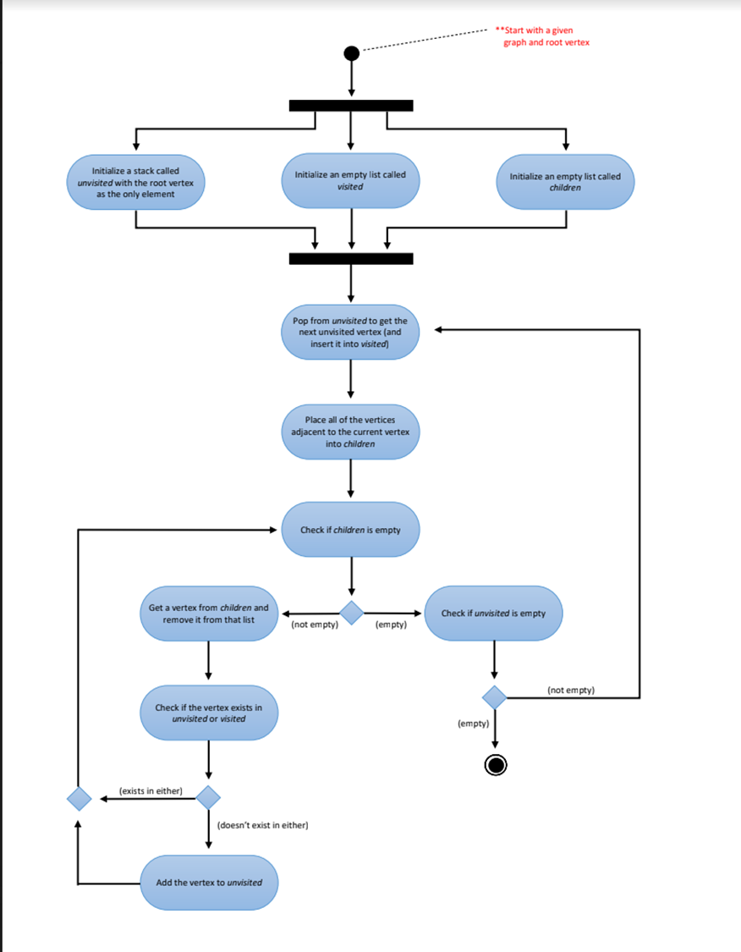
Homework
1
2
3
4
5
Unvisited
1
Visited
Children
Current =

Slide 44
Homework
Pop from Unvisited to get ‘Current’ and insert it into visited
1
2
3
4
5
Unvisited
Visited
1
Children
2, 3
Current = 1

Slide 45
Homework
1
2
Get new ‘Current’ from ‘Children’ and remove it from that list
3
4
5
Unvisited
2
Visited
1
Children
2, 3
Current = 2

Slide 46
1
2
3
4
5
Unvisited
2
Visited
1
Children
2, 3
Current = 2

Slide 47
Homework
1
2
Get new ‘Current’ from ‘Children’ and remove it from that list
3
4
5
Unvisited
Visited
1, 3, 5, 4, 2
Children
2, 3, 1, 4, 5, 3, 4, 3, 5
Current = 2

Slide 48
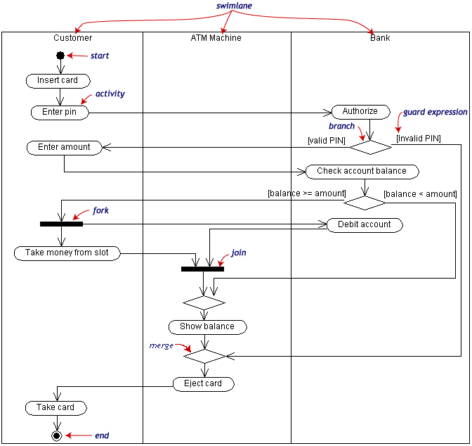
Activity Diagram Example

Slide 49
Homework
1
2
3
4
5

Slide 50
Homework
1
2
3
4
5
Unvisited
1
Visited
Children
Current =

Slide 51
Homework
Pop from Unvisited to get ‘Current’ and insert it into visited
1
2
3
4
5
Unvisited
Visited
1
Children
2, 3
Current = 1

Slide 52
Homework
1
2
Get new ‘Current’ from ‘Children’ and remove it from that list
3
4
5
Unvisited
2
Visited
1
Children
2, 3
Current = 2

Slide 53
Homework
1
2
Get new ‘Current’ from ‘Children’ and remove it from that list
3
4
5
Unvisited
2, 3
Visited
1
Children
2, 3
Current = 3

Slide 54
Homework
Pop from Unvisited to get ‘Current’ and insert it into visited
1
2
3
4
5
Unvisited
2
Visited
1, 3
Children
2, 3, 1, 4, 5
Current = 3

Slide 55
Homework
1
2
Get new ‘Current’ from ‘Children’ and remove it from that list
3
4
5
Unvisited
2
Visited
1, 3
Children
2, 3, 1, 4, 5
Current = 1

Slide 56
Homework
1
2
Get new ‘Current’ from ‘Children’ and remove it from that list
3
4
5
Unvisited
2, 4
Visited
1, 3
Children
2, 3, 1, 4, 5
Current = 4

Slide 57
Homework
1
2
Get new ‘Current’ from ‘Children’ and remove it from that list
3
4
5
Unvisited
2, 4, 5
Visited
1, 3
Children
2, 3, 1, 4, 5
Current = 5

Slide 58
Homework
1
2
3
4
5
Unvisited
2, 4
Visited
1, 3, 5
Children
2, 3, 1, 4, 5, 3, 4
Current = 5

Slide 59
Homework
1
2
Get new ‘Current’ from ‘Children’ and remove it from that list
3
4
5
Unvisited
2, 4
Visited
1, 3, 5
Children
2, 3, 1, 4, 5, 3, 4
Current = 3

Slide 60
Homework
1
2
Get new ‘Current’ from ‘Children’ and remove it from that list
3
4
5
Unvisited
2, 4
Visited
1, 3, 5
Children
2, 3, 1, 4, 5, 3, 4
Current = 4

Slide 61
Homework
Pop from Unvisited to get ‘Current’ and insert it into visited
1
2
3
4
5
Unvisited
2
Visited
1, 3, 5, 4
Children
2, 3, 1, 4, 5, 3, 4, 3, 5
Current = 4

Slide 62
Homework
1
2
Get new ‘Current’ from ‘Children’ and remove it from that list
3
4
5
Unvisited
2
Visited
1, 3, 5, 4
Children
2, 3, 1, 4, 5, 3, 4, 3, 5
Current = 3

Slide 63
Homework
1
2
Get new ‘Current’ from ‘Children’ and remove it from that list
3
4
5
Unvisited
2
Visited
1, 3, 5, 4
Children
2, 3, 1, 4, 5, 3, 4, 3, 5
Current = 5

Slide 64
Homework
Pop from Unvisited to get ‘Current’ and insert it into visited
1
2
3
4
5
Unvisited
Visited
1, 3, 5, 4, 2
Children
2, 3, 1, 4, 5, 3, 4, 3, 5
Current = 2

Slide 65
Homework
1
2
Get new ‘Current’ from ‘Children’ and remove it from that list
3
4
5
Unvisited
Visited
1, 3, 5, 4, 2
Children
2, 3, 1, 4, 5, 3, 4, 3, 5
Current = 2

